Slide 1



Title I Annual Parent Meeting
Mildred Helms IB World Elementary School
Wednesday, August 31, 2022
Shannon Brennan, Principal

Slide 2
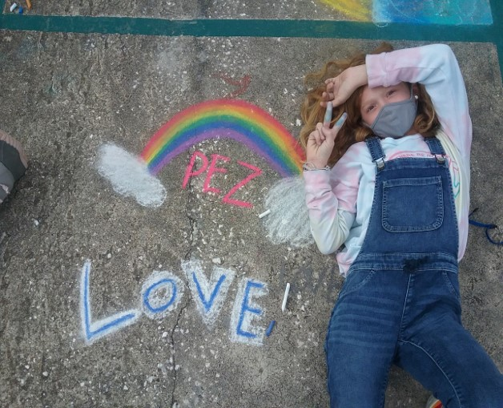
About Title I
Title I is the largest federal assistance program for our nation’s schools.
The goal of Title I is to address the academic needs of students and to assist them in meeting their state’s academic standards.
The program serves 75 schools in Pinellas County including eligible students in 34 non-public schools.

Slide 3
Title I Funding
Pinellas County Schools
Increased Student Achievement
Federal Government
1
3
2
4
Florida Department of Education
Mildred Helms IB World Elementary School
Notes:
The Florida Department of Education receives funds from the federal government. Districts receive Title I funds from Department of Education, and the school district distributes these funds to schools based on the percentage of children eligible for free/reduced price lunch; however, students do not have to be from low-income families to receive help.

Slide 4

Title I Schoolwide Budget
Mildred Helms is provided $220,767.35 to pay for supplemental resources.
Title I funds provide an Intervention Teacher, an MTSS Coach and two Hourly Teachers to support student achievement.

Slide 5

Supplemental
Definition: provided in addition to what is already present or available to complete or enhance it.
https://languages.oup.com/
Notes:
Title I is supplemental federal funding that provides extra academic support and learning opportunities.

Slide 6
Title I Programs Provide Supplemental Support
Supplemental Resource | Positive Impact
MTSS Coach Part Time Hourly Teacher Intervention Teacher | The MTSS (Multi-Tiered System of Supports) Coach focuses on professional development, achievement data, interventions to increase student achievement Hourly Teachers and Paraprofessionals provide small group instruction
Instructional Materials | Curriculum materials to support instruction
Curriculum Development | Teachers plan IB Units
Parent and Family Engagement Resources and Training Workshops
Notes:
Use additional slides if necessary. This is where you want to really highlight Title I funding and how it positively impacts your scholars! Additional supplemental personnel (add specific positions)

Slide 7
Title I Parent & Family Engagement 22-23 Budget
Total Allocation - $6,400.00
Teachers Stipends to Provide Parent Training - $3,768.98
Agenda Books - $2,302.32
Food Purchases - $328.70
Notes:
SAMPLE ONLY - Delete Slide

Slide 8
Title I Schoolwide Planning
First
Second
Last
Input from school, family, and community members determine how Title I funds are used based on a needs assessment.
Please attend online or in-person meetings/trainings and complete surveys to provide input on Title I funding.
All Title I schools must document that parents are involved in the schoolwide planning process.

Slide 9
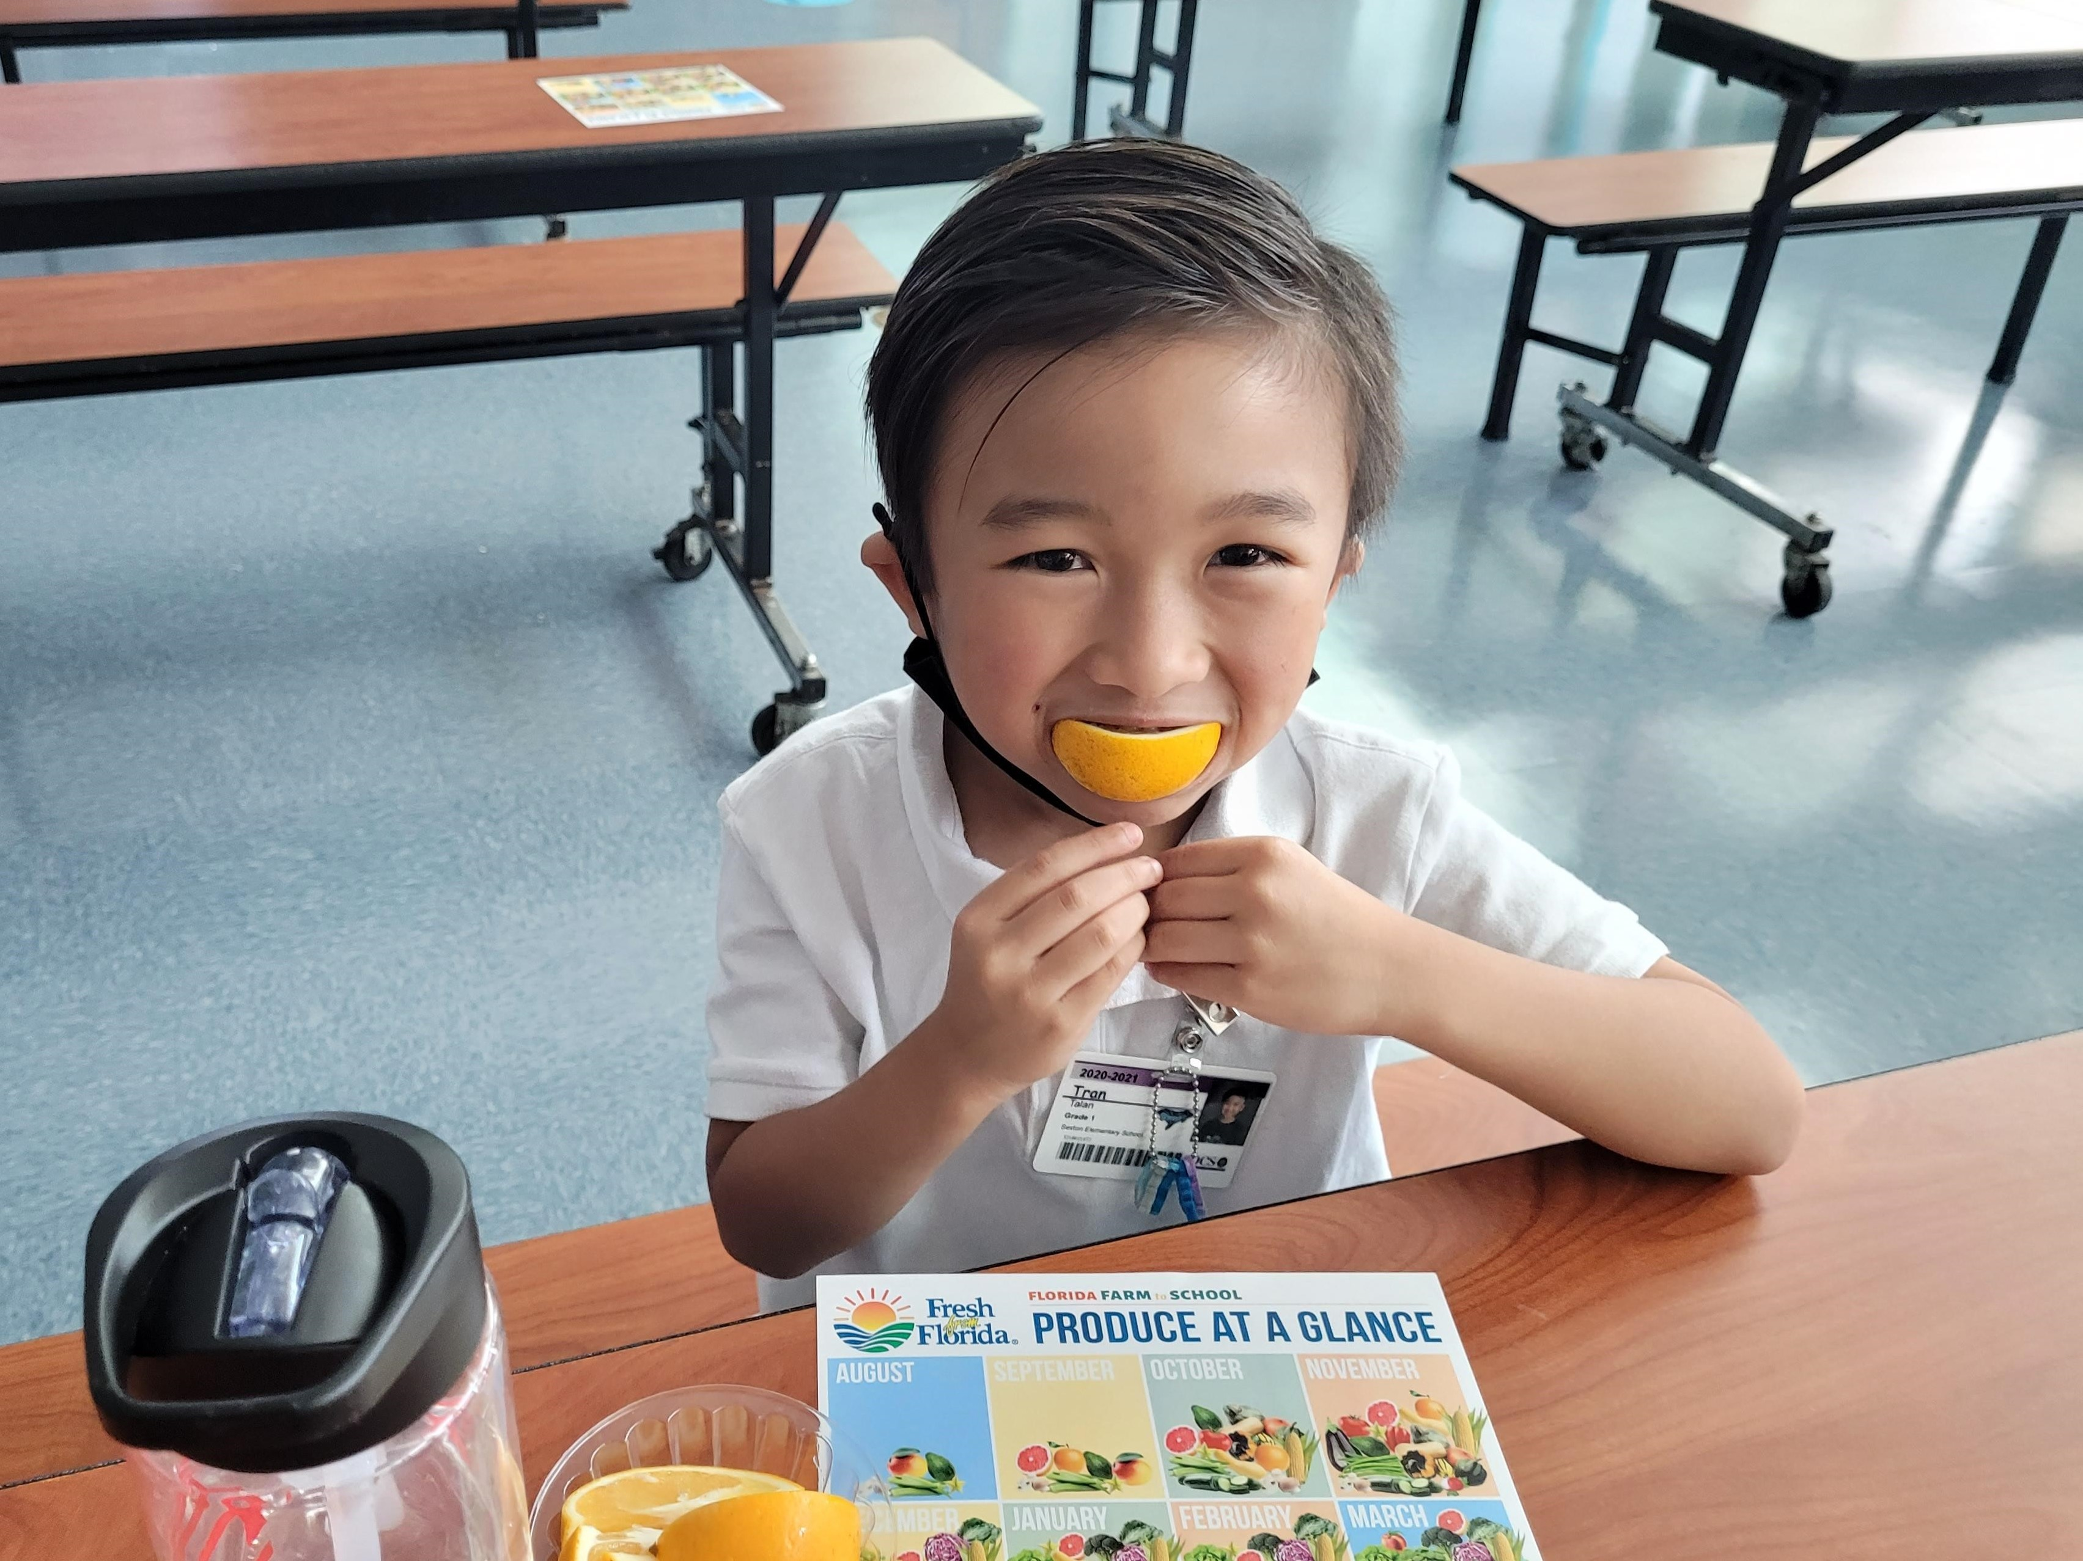
Parent’s Right to Know
As a parent of a student attending a Pinellas County School Public School, you have the right to…
Be provided information on your child’s level of achievement on assessments in Reading/Language Arts, Writing, Mathematics, and Science.
Request and receive information on the qualifications of your child’s teacher and supplemental personnel working with your child.
Be notified of non-highly qualified or out-of-field teachers at the school.
Be informed if your child is taught by a non-highly qualified teacher for four or more consecutive weeks.

Slide 10
Working Together for Student Success
As a Title I parent you have the right to be involved in the development of the following plans and documents for our school which can be found on our website to view as well as in the Parent Station located front office.
School Improvement Plan (SIP)
Title I Schoolwide Plan
Parent and Family Engagement Plan (PFEP)
School-Parent-Student Compact
Notes:
Our school’s Title I Parent Station is located in the front office.
You will find a copy of our School Improvement Plan, Title I Schoolwide Plan, School’s PFEP, the School District’s PFEP, Parent’s Right to Know Memo, Upcoming Events, Compact, (insert other documents at your station)

Slide 11
Parent-School-Student Compact
The purpose of the compact is to foster student achievement. By signing the Parent-School-Student Compact, (Insert name of school here), teachers, staff, parents and students agree to work together to share the responsibility of helping students meet or exceed state, district and school academic goals.
The Parent-School-Student Compact is updated every year to include parent, student, teacher, and staff input. Parent, student, teacher and staff comments are welcome at any time during the year.
Please review and sign your child’s Compact.
Our goal is to receive 100% participation!

Slide 12
As a Parent,

Slide 13
Parent and Family Engagement Plan (PFEP)
The PFEP Sections include information about the following:
Family Events that provide opportunities for parents and children to connect with standards-based curriculum and the IB Units
Notes:
Provide information on the specific committees that parents can be involved. Include the purpose, date and time of meetings.
Explain the PFEP and its purpose.

Slide 14
We want YOU!
Parent Advisory Council (PAC)

Slide 15
Parent Advisory Council (PAC)
The District has a Parent and Family Engagement Plan. The summary of the this plan is in the Title I School & Family Partnership Overview.
You may access the full plan at www.pcsb.org/titleone
The Parent Advisory Council (PAC) is responsible for reviewing and revising the District PFEP.
PAC will meet virtually or in-person with the district’s Title I Family Education Coordinator.
PAC meets twice a year, if you are interested in representing our school please notify, Mrs. Brennan.
Notes:
Please add your PAC representative in slide and email Amy Brown the contact at brownamyl@pcsb.org

Slide 16
Accountability
  School Report Cards
  School Grade and Overview
  Population and Enrollment
  Assessments – Academic Achievement, Growth, and Population
  Assessments – English Language Learners
  Graduation and Beyond
  Educator Qualifications and Equity
  Long-Term Goals and Interim Progress
  Accelerated Course Enrollment
  Per-Pupil Expenditures
  National Data
  Available online at https://edudata.fldoe.org/ or Front Office

Slide 17
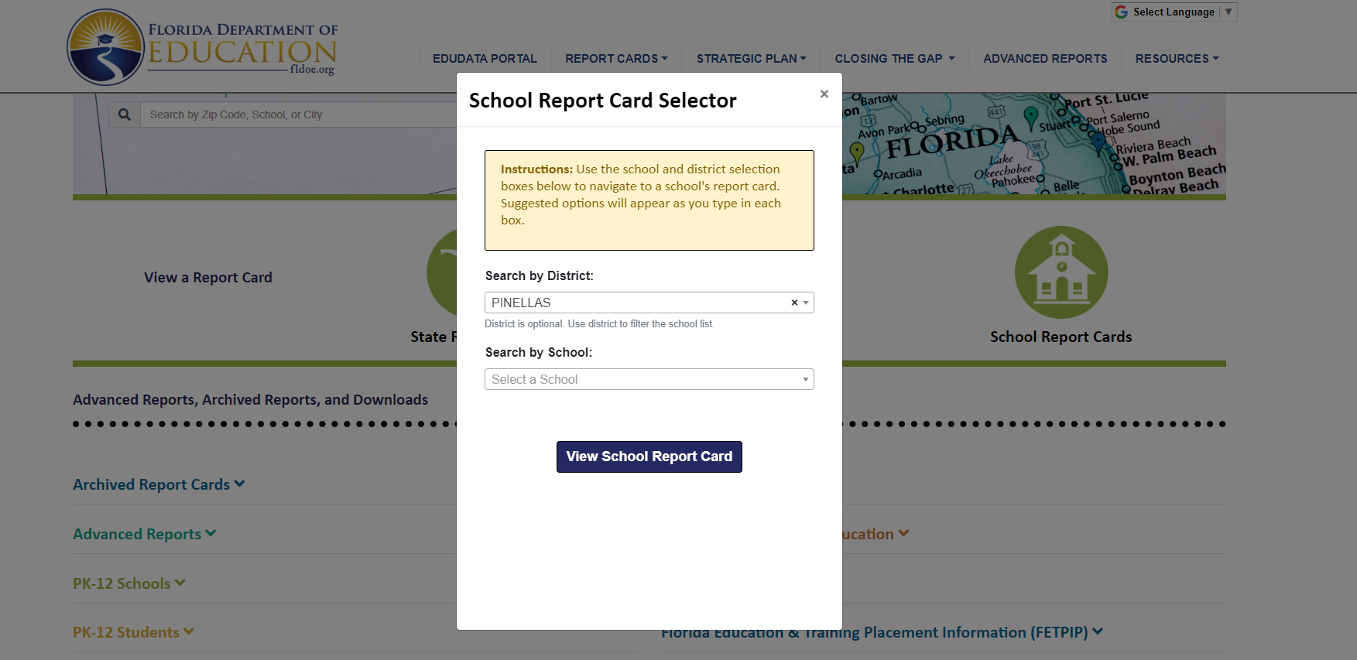
Visit to find district and school grades, EduData Portal
Notes:
When you follow the link EduDataPortal select Pinellas County and search by school.

Slide 18

Florida Standards
  Florida’s academic content standards establish high expectations for all students.
  Florida Standards identify what your child needs to know and be able to do in all content areas. You may read more information by visiting fldoe.org/academic/standards/.
  Also, your child’s teacher will be able to explain the standards for your child’s grade level.
Notes:
All curriculum, instruction and assessments are based on student-centered expectations.

Slide 19

F.A.S.T.
Florida Assessment of Student Thinking (F.A.S.T.)
Fall, Winter and Spring Assessments-
STAR Early Literacy – VPK, Kindergarten and 1st Grade
STAR Literacy – 2nd Grade
STAR Math – Kindergarten – 2nd Grade
Cambium Gr 3-10
Math Gr 3-8
Science Grs 5 and 8

Slide 20

Florida Benchmark For Excellent Student Thinking Standards (B.E.S.T). You may read more information by visiting, http://www.fldoe.org/standardsreview/
Notes:
All curriculum, instruction and assessments are based on student-centered expectations.

Slide 21
Next Steps
We encourage you to…
Review the Compact throughout the year as it relates to your child(ren)’s goals
Communicate with the teachers and other staff
regularly
Participate in giving your input for our SIP, PFEP, and Compact

Slide 22
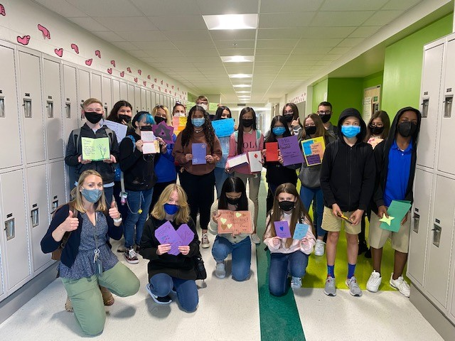

Additional Resources
Learning at Home Family Resources - https://www.pcsb.org/Page/32836
Volunteer in a Pinellas County School - https://www.pcsb.org/Page/459
Parent Academy POWER HOURS Webinars - https://www.pcsb.org/Page/26534
Partnerships - https://www.pcsb.org/Page/418

Slide 23
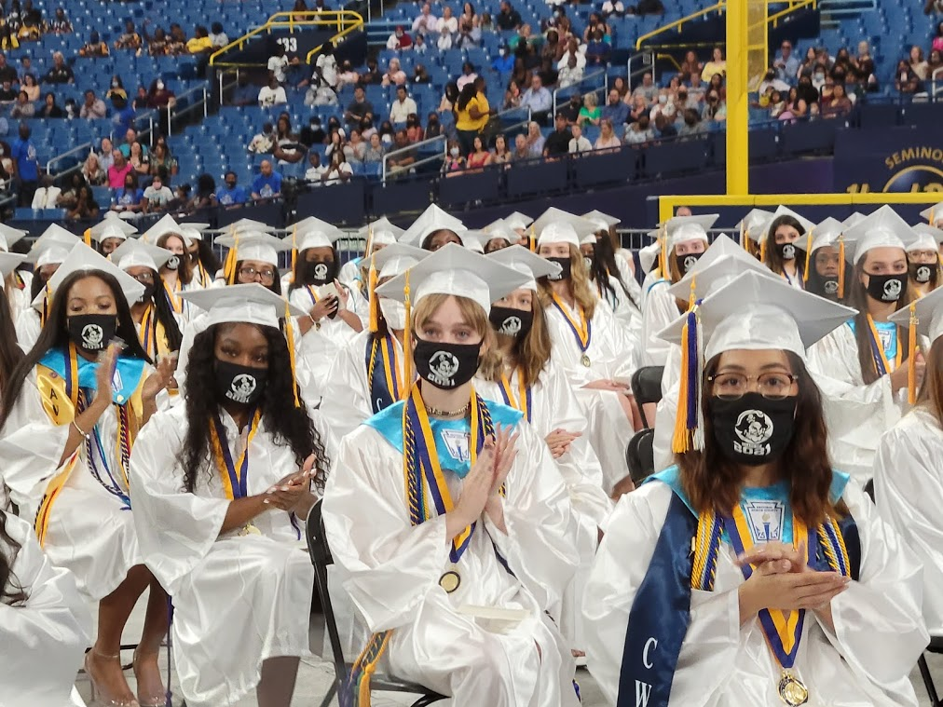
We appreciate your time!
Please feel free to ask any questions and provide feedback on our Title I Program.

Slide 24
Education is for improving the lives of others and for leaving your community and world better than you found it.
Marian Wright Edelman

Slide 25
Please take the time to participate in our survey.
Your feedback is greatly appreciated!
Notes:
Please duplicate Microsoft Forms provided or create school survey. To generate a QR code hover over your school’s survey and and right click. Create QR code for this page will be an option.

